Slide 1
REPOST (Review & post)
Arvind Nair
Pulkit Sood
CSCI – 59000 Advanced Mobility & Cloud Computing

Slide 2
MOTIVATION
Offer users the ability to search for places of interest based on reviews.
Offers users a platform to discuss about various hobbies/interests.
Offers ability to search for customized places.
Ensures authenticity of reviews posted.

Slide 3
INTRODUCTION
Repost offers the following features:
Post a review
Follow other users
Vote & spam features
Search functionality
Chat with other users
Map functionality

Slide 4
POST A REVIEW
Users can post reviews about various places they visit or have visited.
Hashtag is optional but helps in search.
Max length : 360 characters
It is time-stamped with a location feature attached.

Slide 5
FOLLOW OTHER USERS
A user may follow other users to get updates.
Once a user follows another user, the updates posted will appear on your wall.
User may unfollow another user as well if their reviews are uninteresting.
Once a user is unfollowed, the reviews posted by them will not appear on the news feed.

Slide 6
VOTE AND SPAM
A user can rate a review via voting. Voting range from 1 to 5 stars.
Vote stats represents the average vote the review has received.
A user may report a review spam if she/he feels that it is misleading/suspicious.
A user may vote or report spam only once.
Users are NOT allowed to vote on/report spam their own reviews. (Obviously!)

Slide 7
SEARCH
A user may search for reviews based on hashtags.
A user may search and read about specific places of interest before visiting them.
The vote and spam statistics are handy here as a user can judge if the place she is going to is good or not.
This will help users not to waste money!

Slide 8
CHAT
Users may chat with other users in the chat room and are time-stamped.
A user may or may not follow the people with whom she/he interacts in the chat room.
Chat room offers anonymity to users.
Chats are not persistent.

Slide 9
MAP
Uses Google Places API.
Users can search for places of interest on the map.
Users can search from a variety of categories.
Users can also search for places within a particular distance.
Providing a keyword is optional.

Slide 10
WHY TO DEPLOY ON CLOUD?
Ease of access
Scalability
Minimal cost (money saved is money earned!)
Redundancy and Robustness
Legal contract

Slide 11
FUTURE WORK
Recommendation based ads and reviews
Use Google recaptcha
Linking Repost with various social media platforms
Develop stand alone applications for Android and iOS
Location based filtering

Slide 12
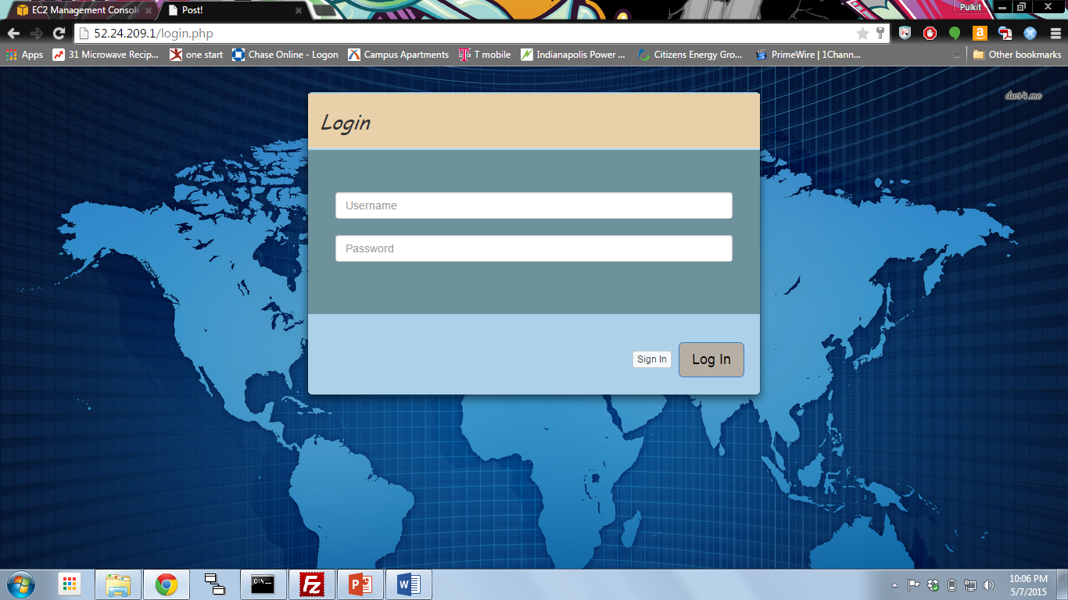
MOVING ON TO THE DEMO…..

